Slide 1

Play Assembly
Number 7
23.04.25

Slide 2

Celebrate
Well done to all the fantastic tidying superstars in our school! Keep it up!

Slide 3
Who can remember what is on our OPAL play charter?

Slide 4


Hoylake Holy Trinity’s OPAL Charter
• We are kind and fair to each other.
• We keep everyone safe and are aware of others around us.
• We take responsibility in how we use and share our resources.
• We are respectful.
• We encourage others to join in with our play.
• We listen to one another and help others if they need it.
• We ask for adult support if we are unsure.

Slide 5
Water Area
Taps - Why do you think they were taken away?
Safe
not safe

Slide 6
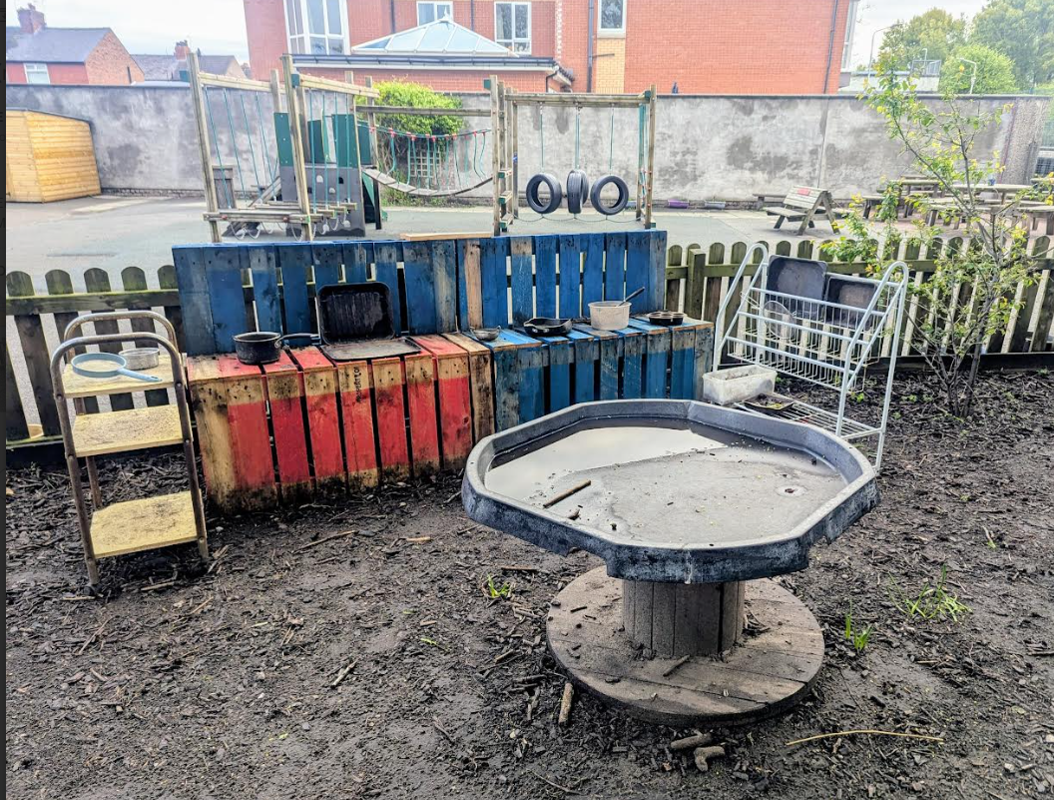
Mud Kitchen Area
What is going well?
Safe
not safe

Slide 7
Digging Area
Safe
not safe

Slide 8
Let’s have a look at some of our new OPAL equipment
-What can we use these for?
-What are the risks?
-How can we look out for each other and keep each other safe?
Same rules still apply - stacking tyres and reels (how many is too many!?), being aware of who is around you, working as a team or with a friend. Length of sticks.
What’s right for you?

Slide 9
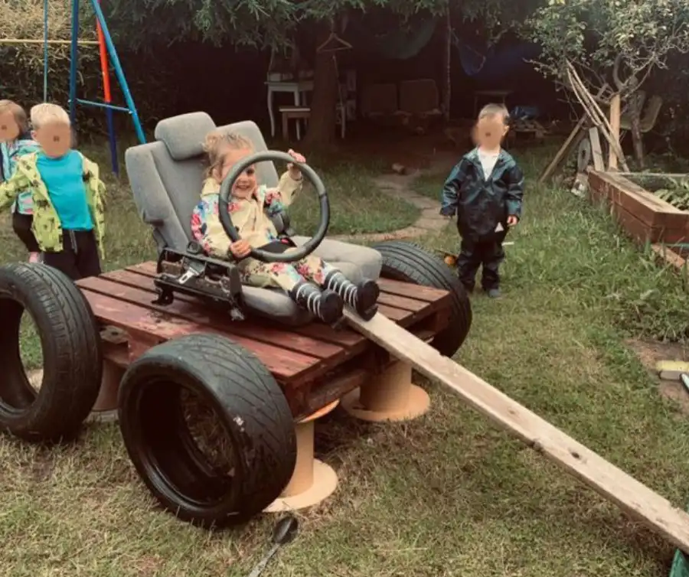
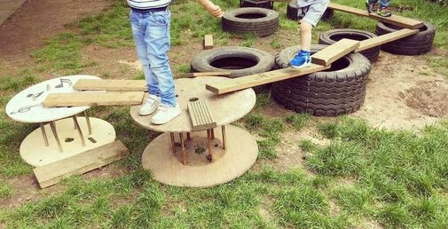
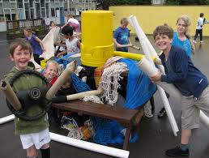
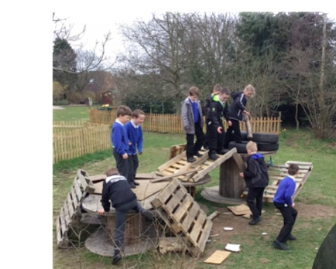

Slide 10
We will be putting all of the new equipment in the KS1 shed, which you will be able to take out at lunchtime
OPAL leadership team
Head boy/girl and deputies
Meeting for 5 minutes

Slide 11
Zootopia - Try Everything (Lyrics, Shakira) - YouTube

