Slide 1

Play Assembly
Number 6

Slide 2
Last assembly
LOOKING AFTER OUR EQUIPMENT
Notes:
Introduce names

Slide 3
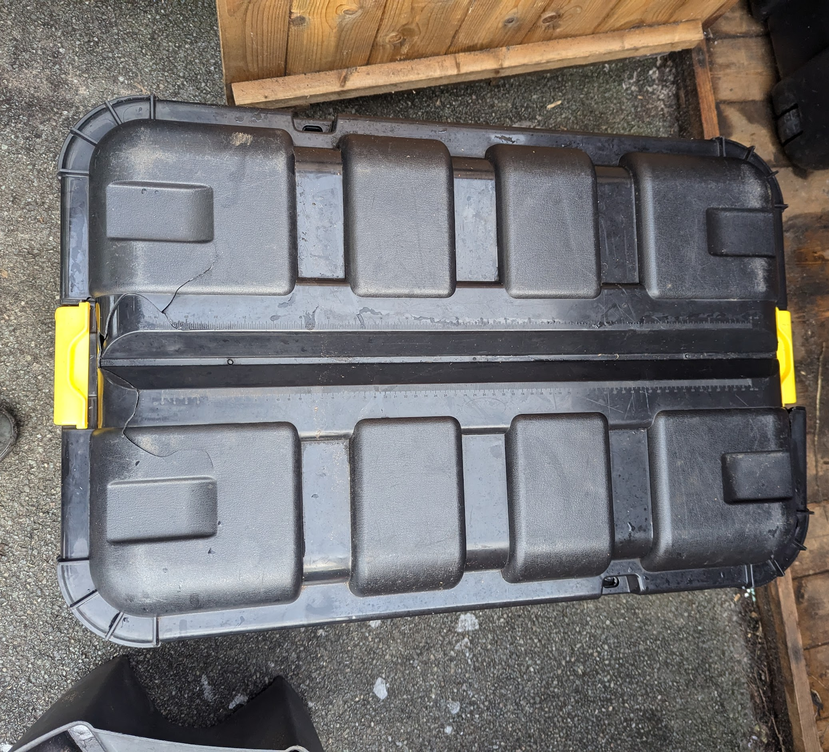
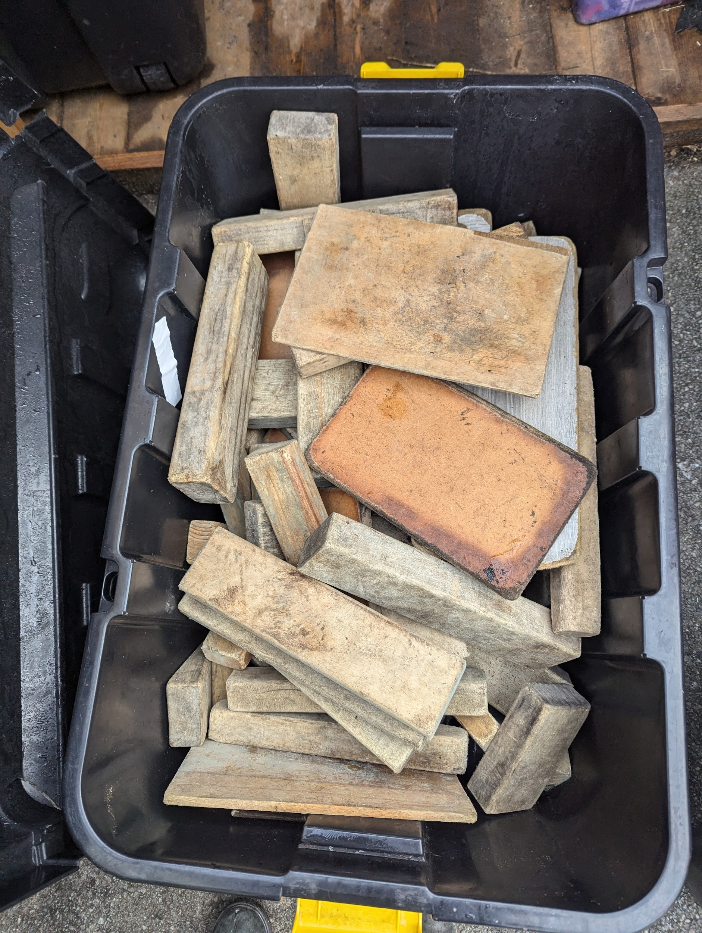
Blocks back in box, lid on

Slide 4
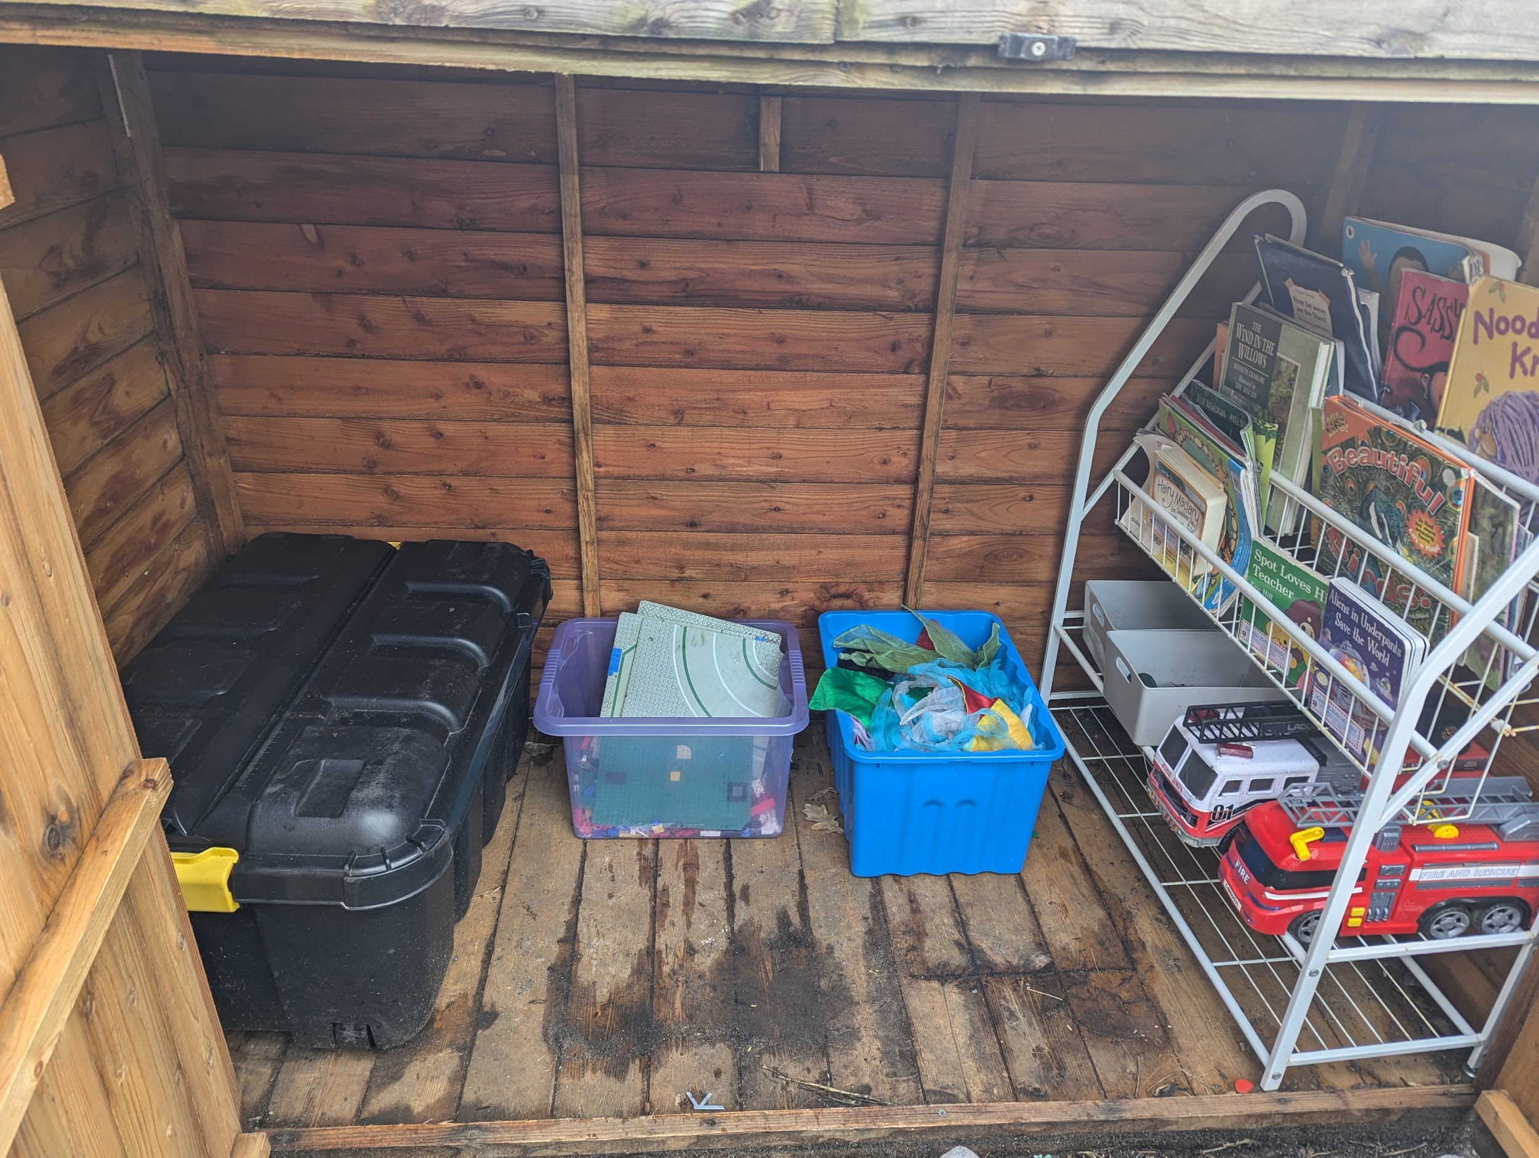
KS1 little shed
What tidy looks like
Blocks
Dressing up
Lego
Books
Small world play

Slide 5
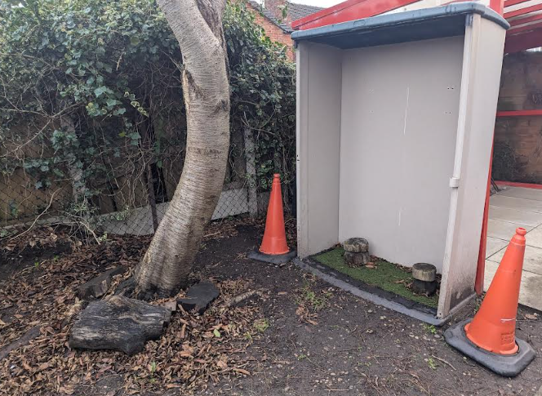
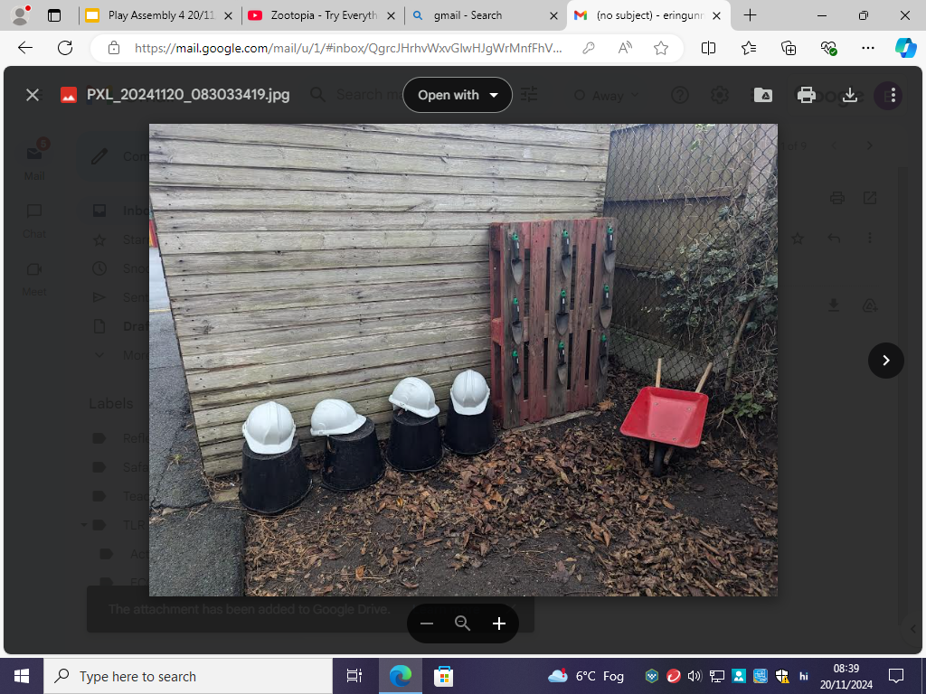
Digging Area
What tidy looks like!

Slide 6
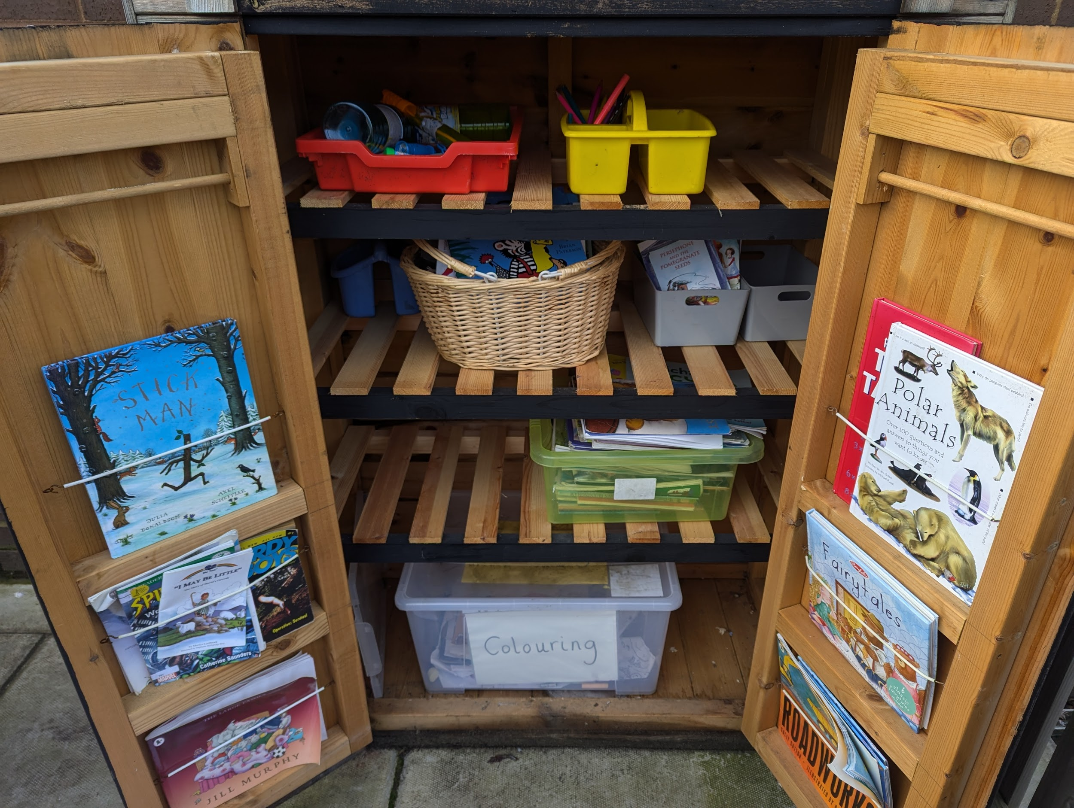
Terrace:
What tidy
looks like

Slide 7
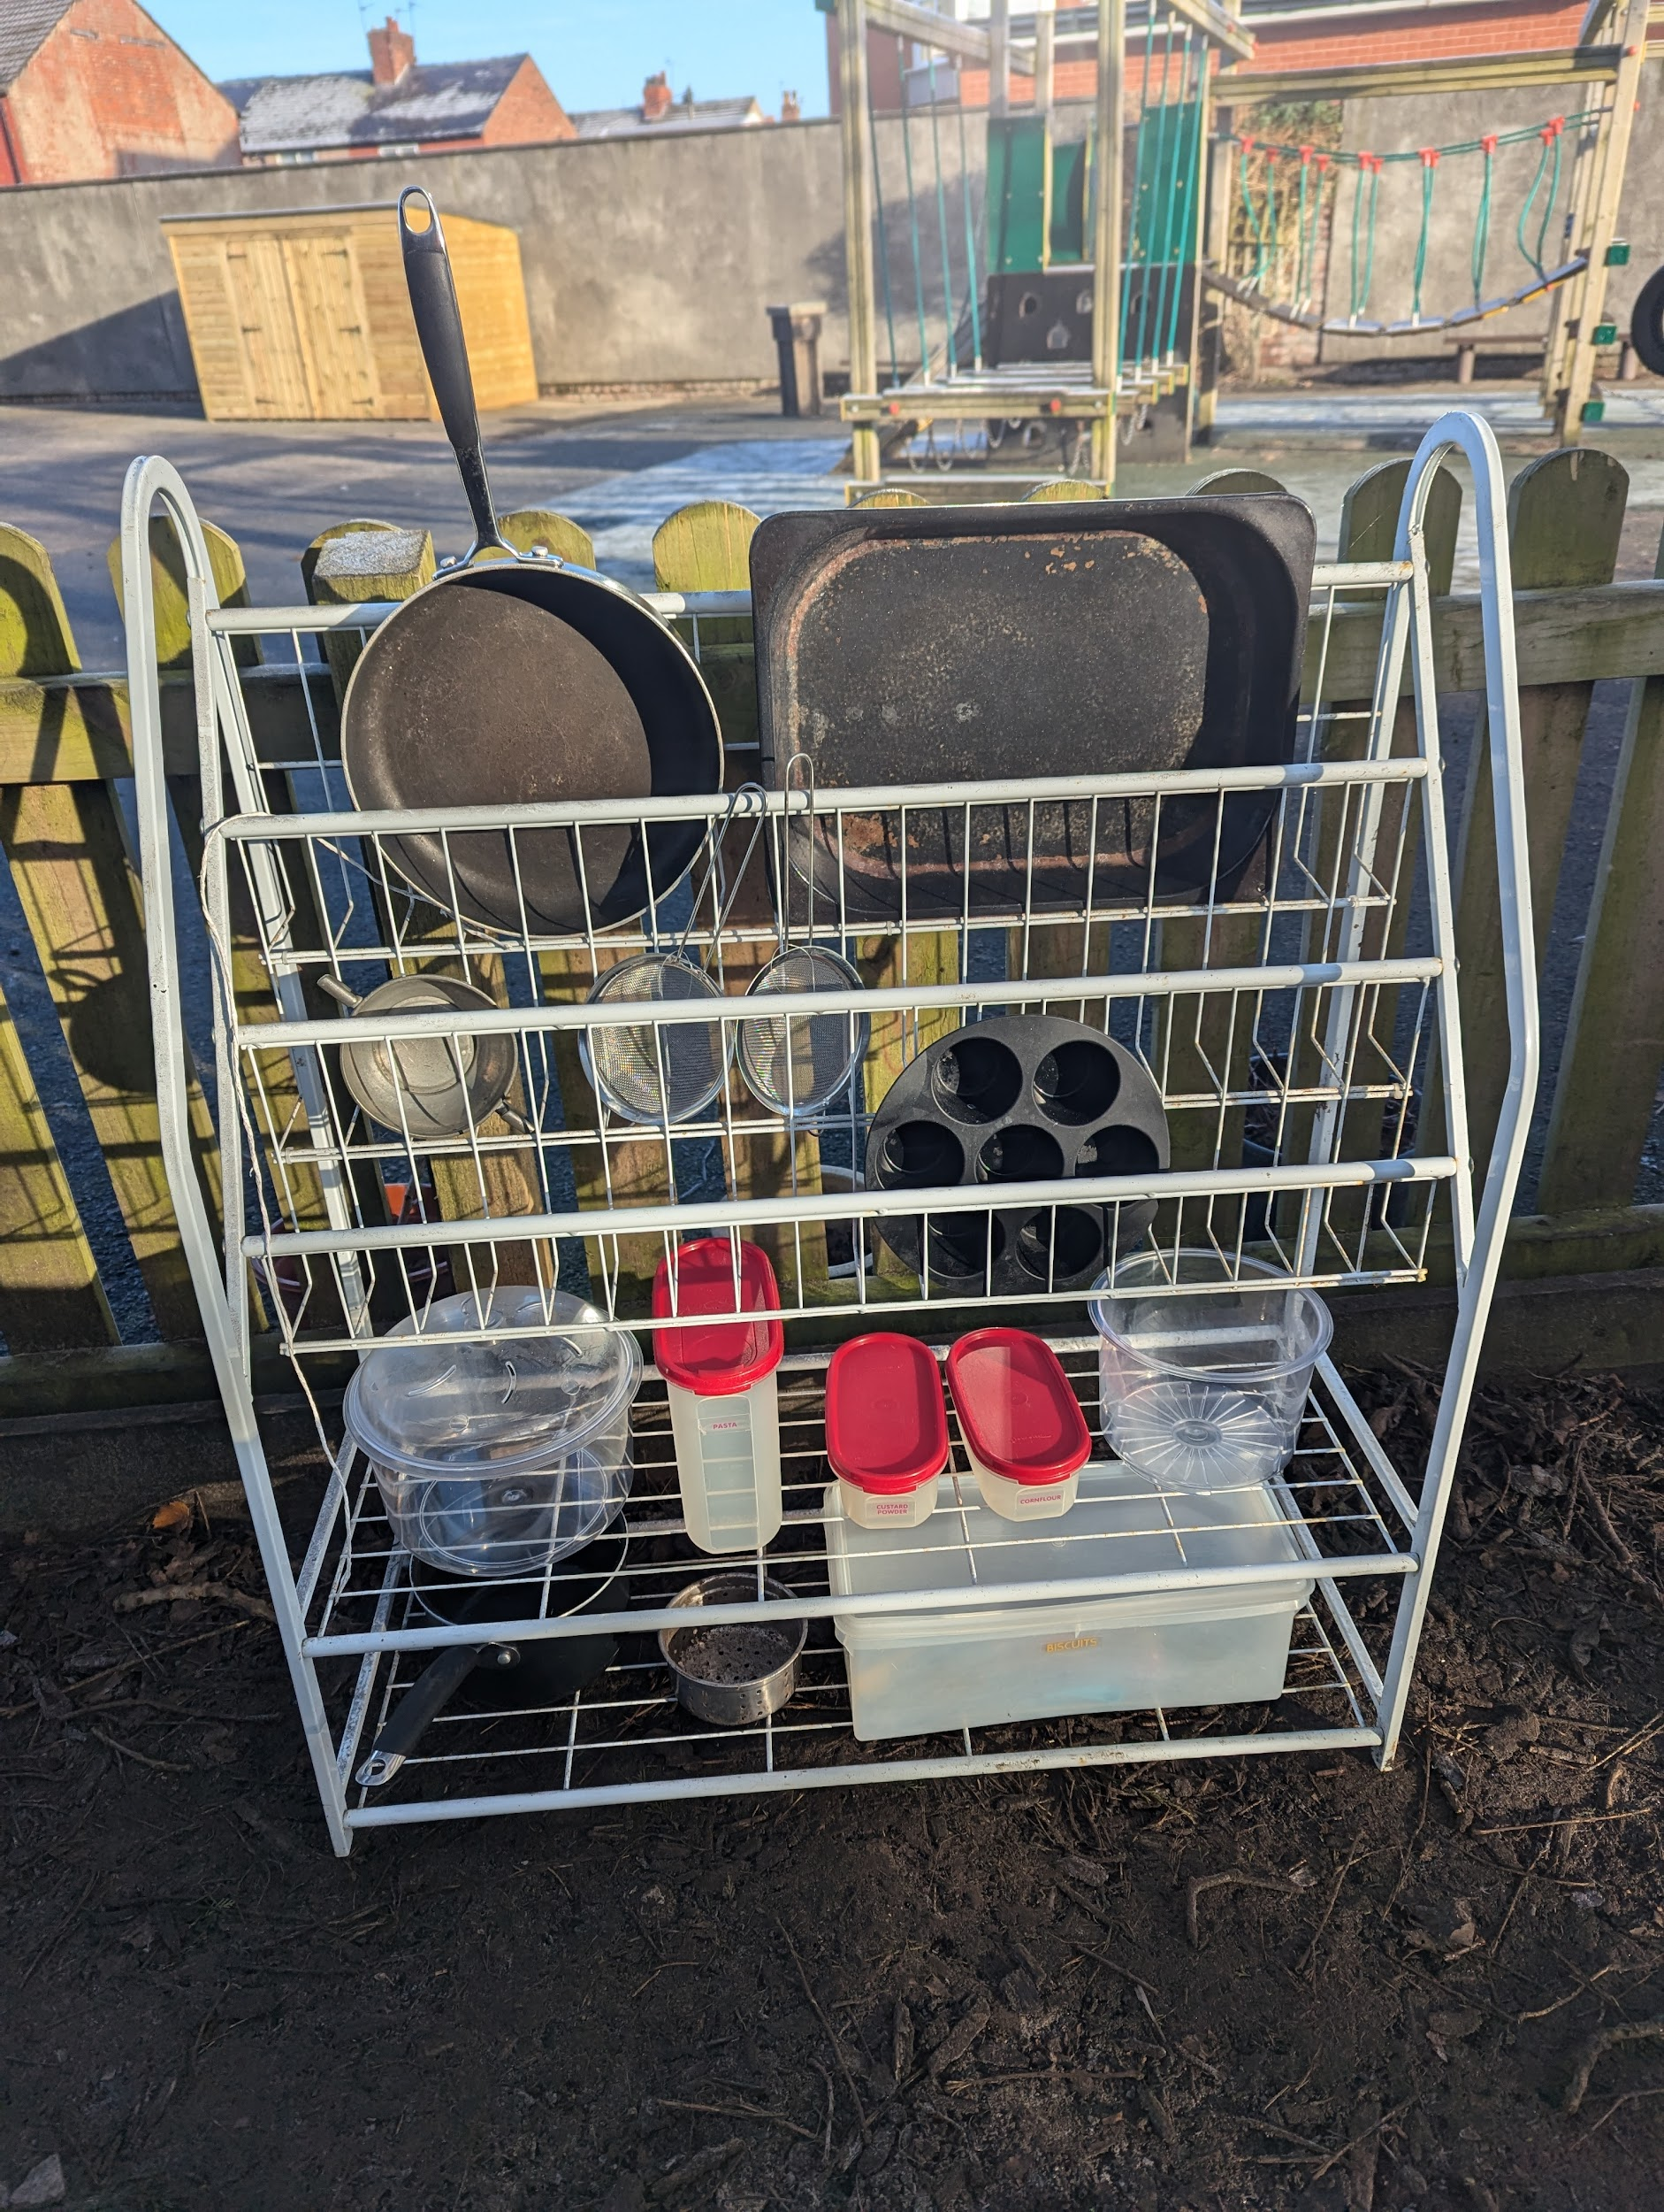
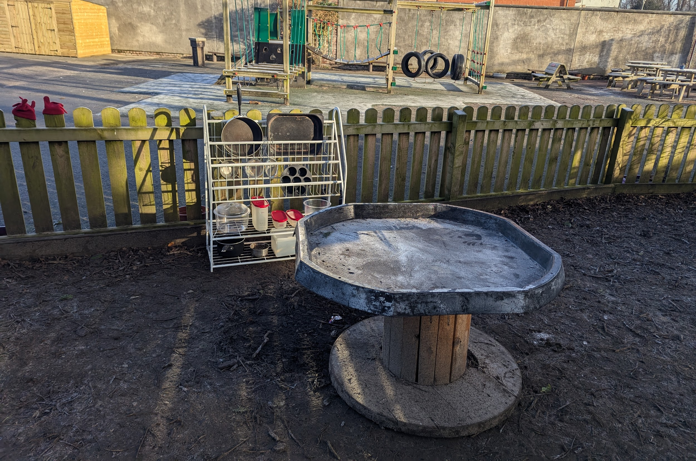
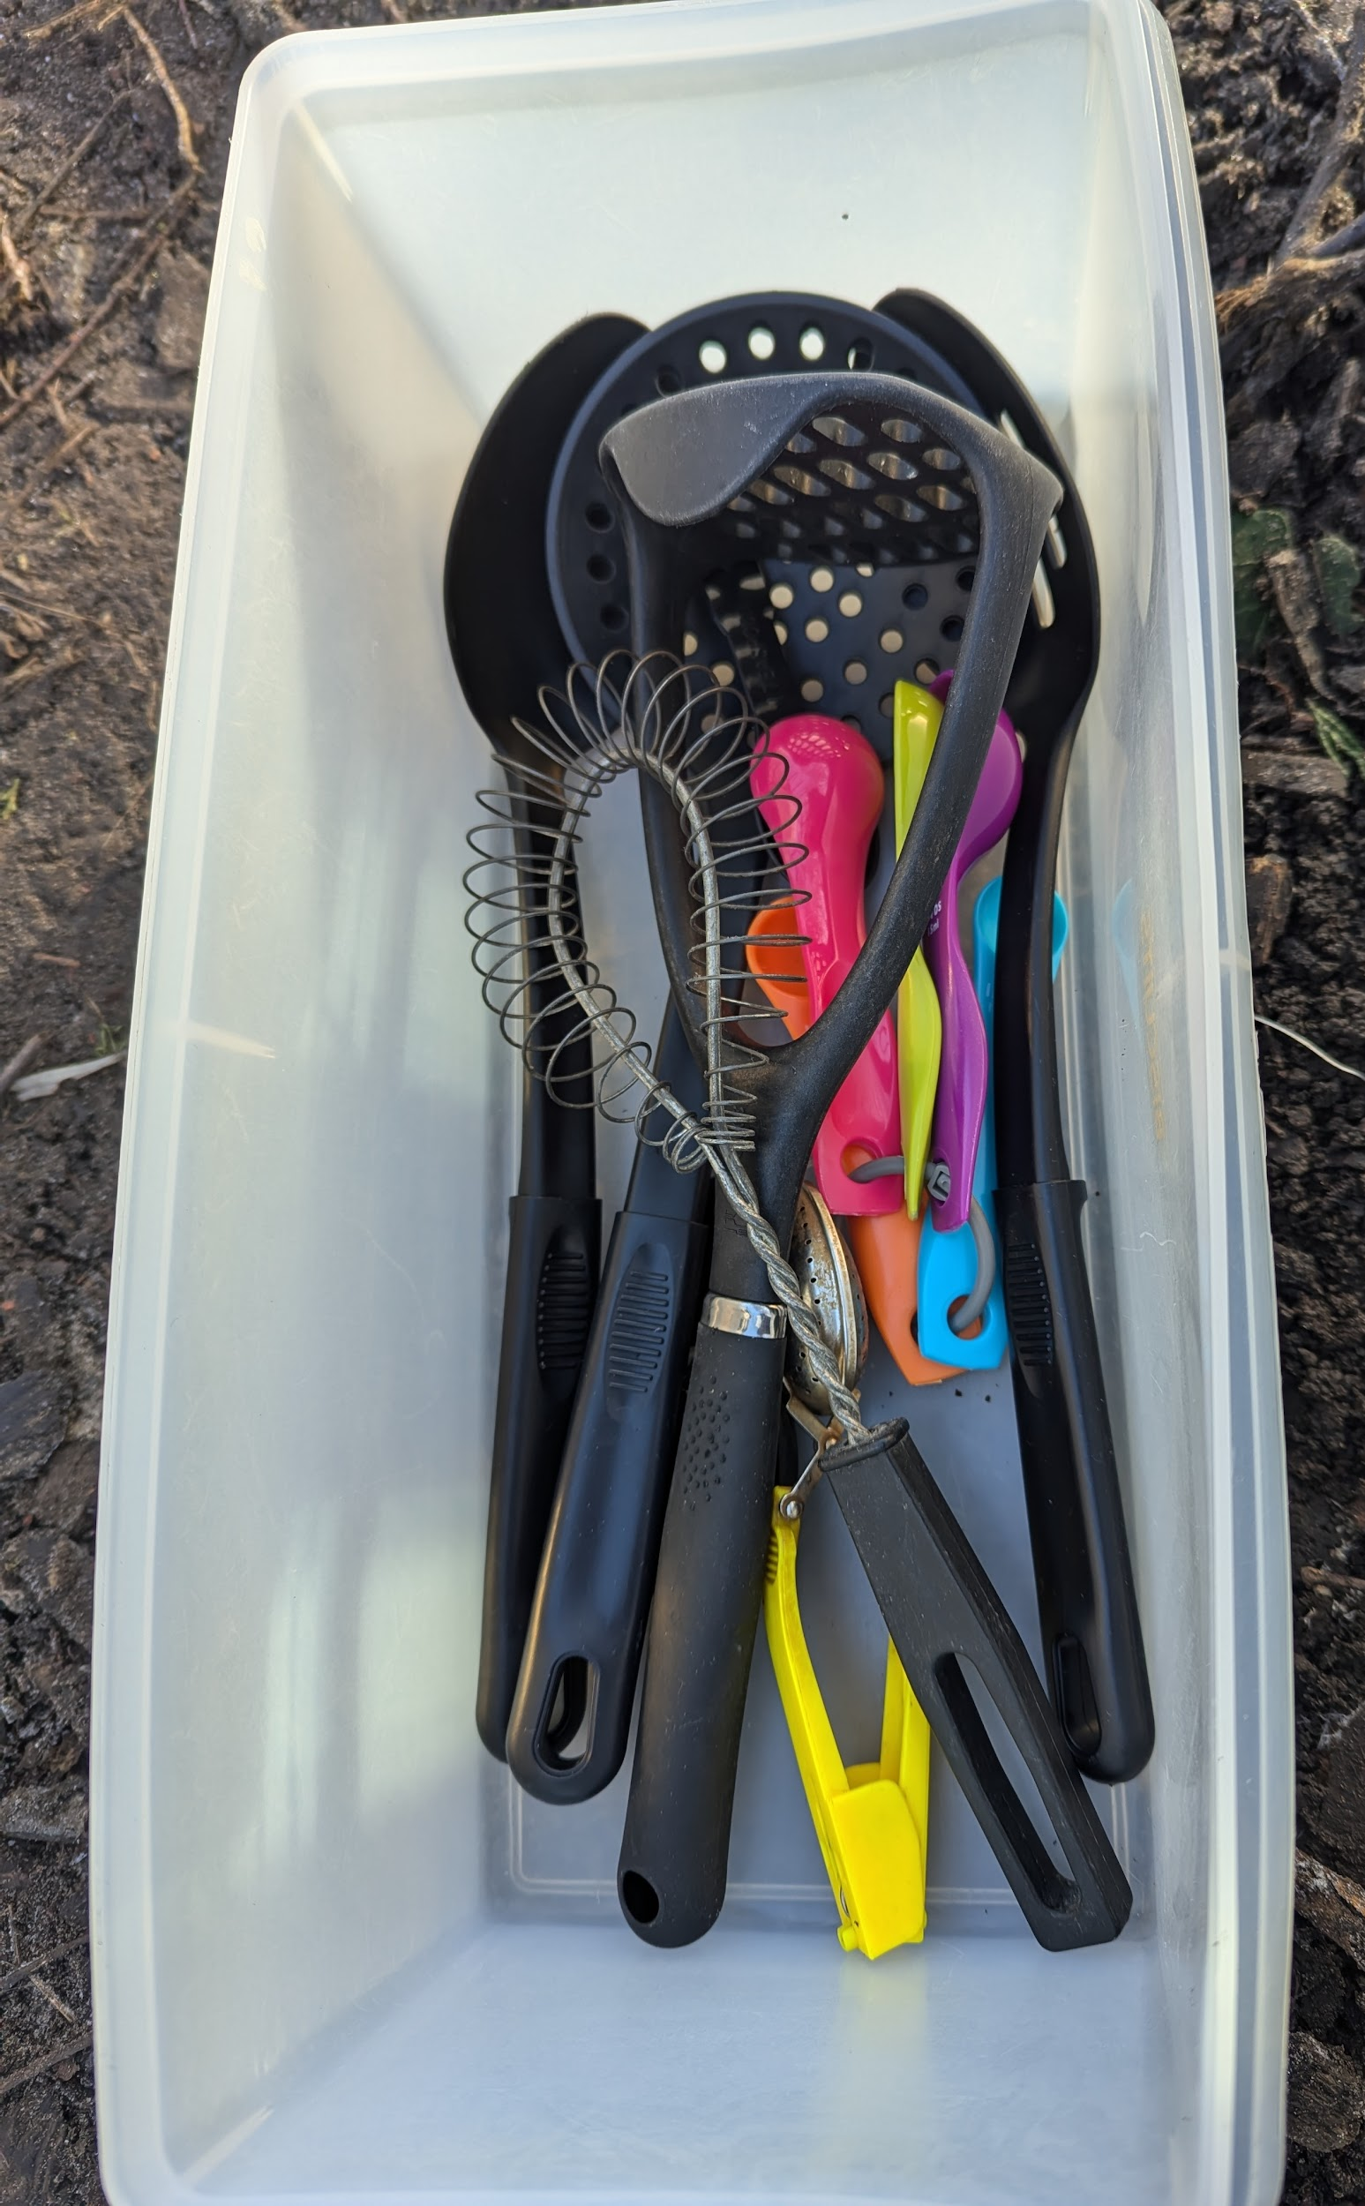
Mud kitchen/cafe - please don’t move the equipment to other areas!

Slide 8

Weekly Tidying award
Tidying Time - aim for 4-5 minutes

Slide 9

OPAL equipment is for lunch time, not morning or afternoon break times.
Can you think why?
Which sticks are only to be used as building?

Slide 10
A huge thank you…
Notes:
Dinosaur box

Slide 11
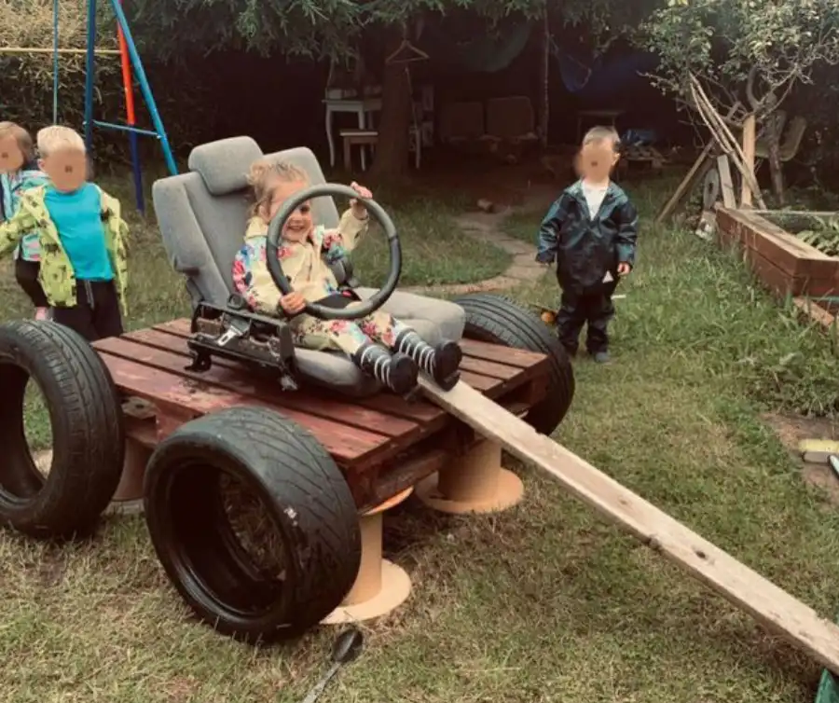
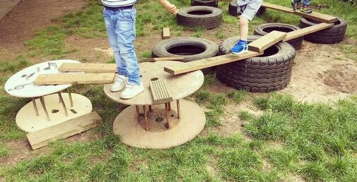
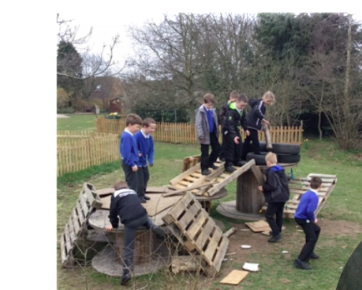
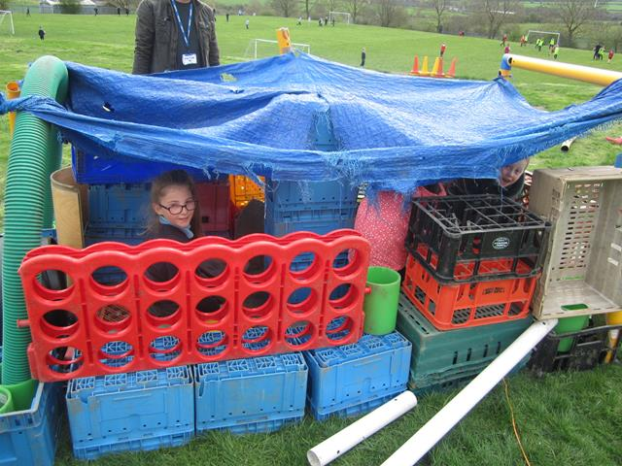
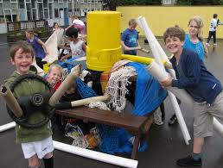

Slide 12
Zootopia - Try Everything (Lyrics, Shakira) - YouTube

