Slide 1

Hoylake Holy Trinity
The Start of our OPAL Journey!
Play Assembly Number 1

Slide 2
What is OPAL and Why are we doing it?
OPAL - Outdoor Play and Learning
Amazing playtimes, everyday, for every child, no exceptions!
Fun and exciting! Independence…
Driven by you - the children! Teamwork…
Building friendships.. Choice…
Free play… Managing risks…
Learning through play… Different opportunities…

Slide 3

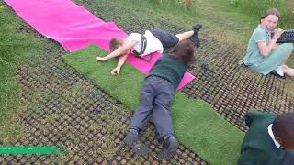
Here is what OPAL can look like and will start to look like as we begin to develop it and make changes across our school…
Watch carefully and choose one thing that you’d like to see on our playgrounds here at HHT!
Notes:
Lets have a look at what it might look like in practice
Hands up who’s excited, hands up who’s a bit nervous, hands up who’s scared out of their minds

Slide 4
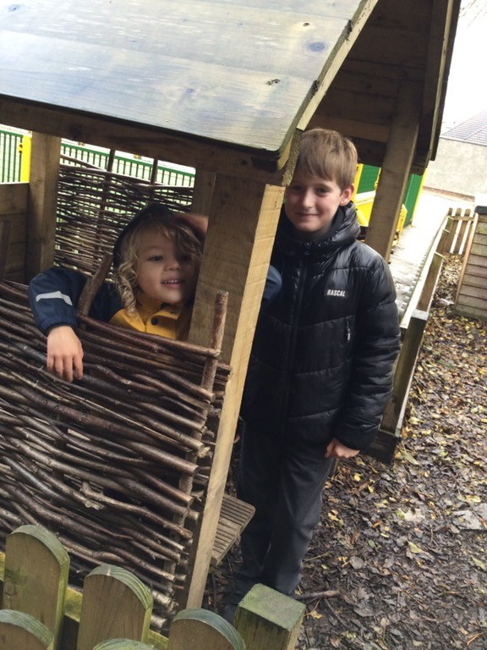
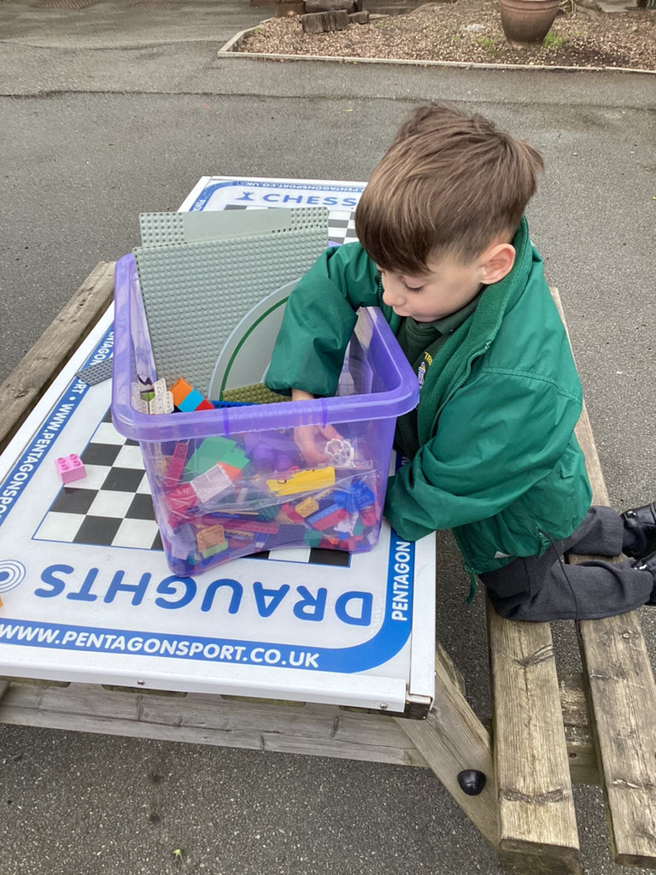
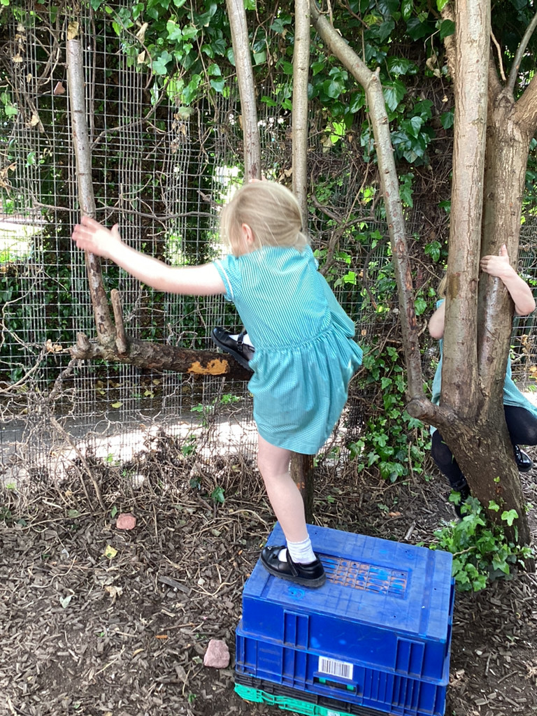
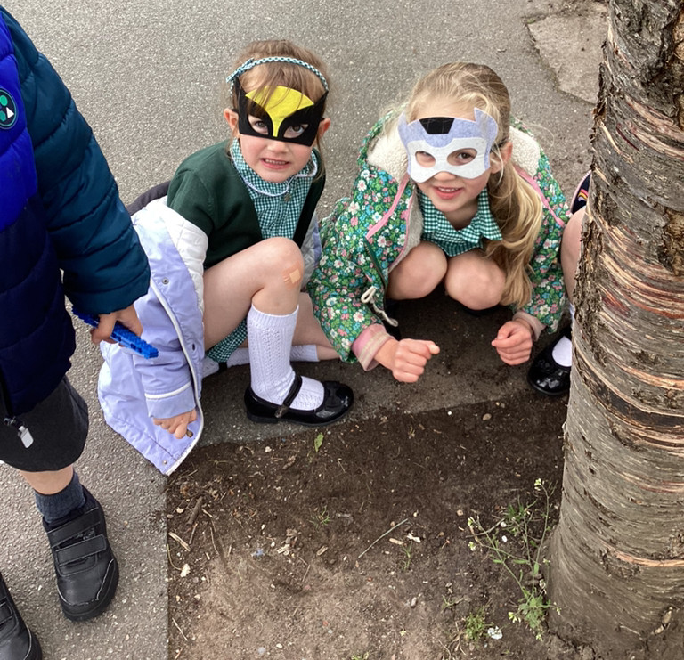
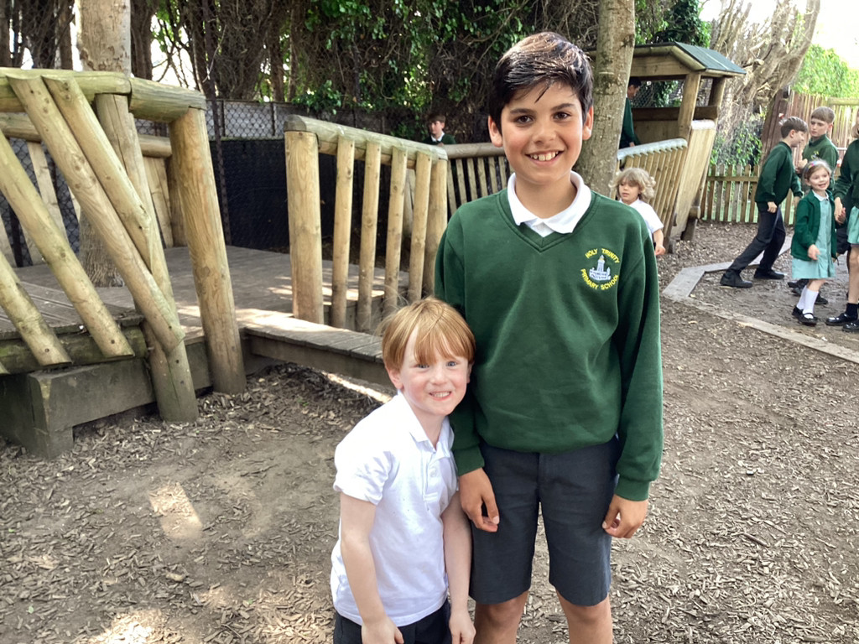
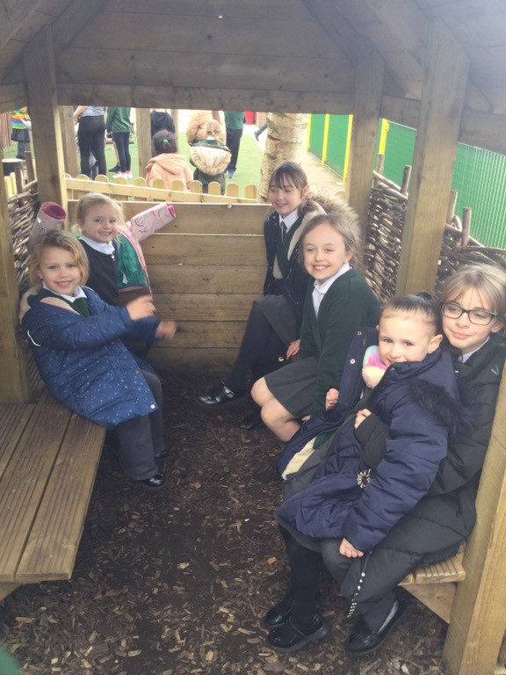
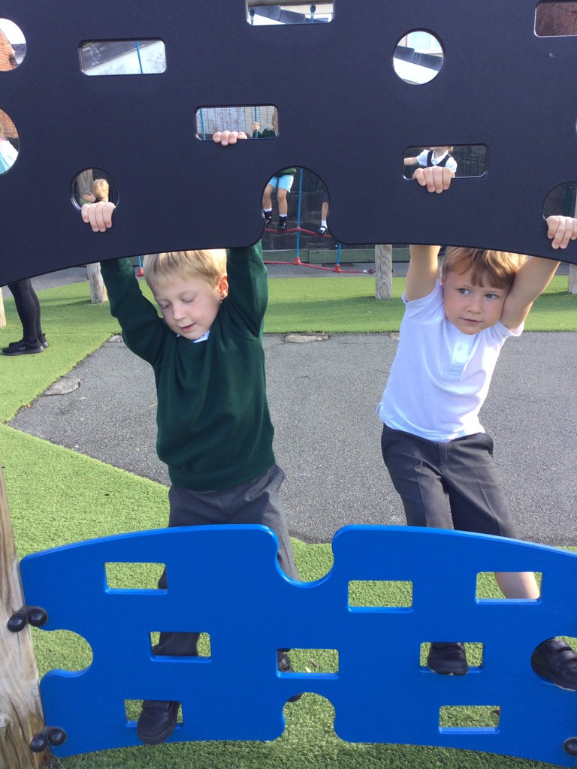
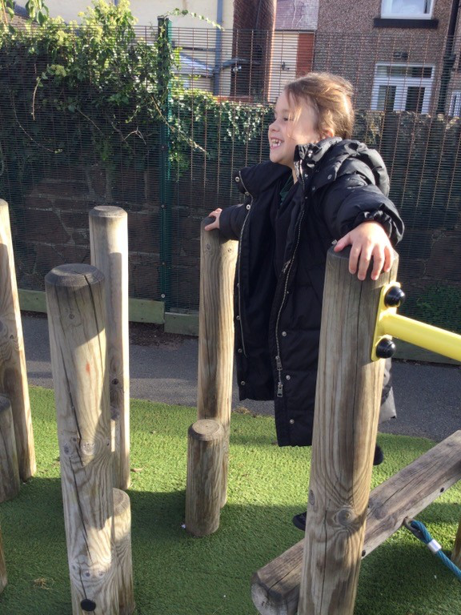
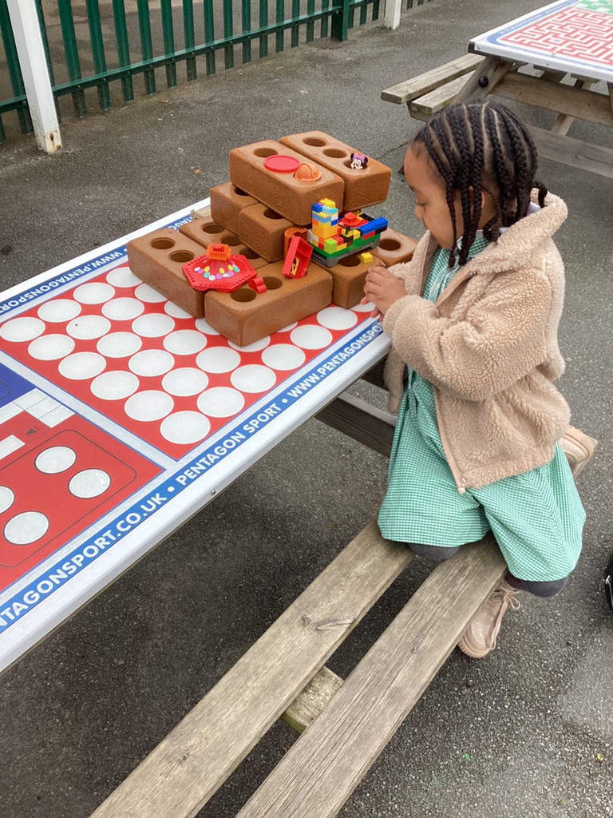
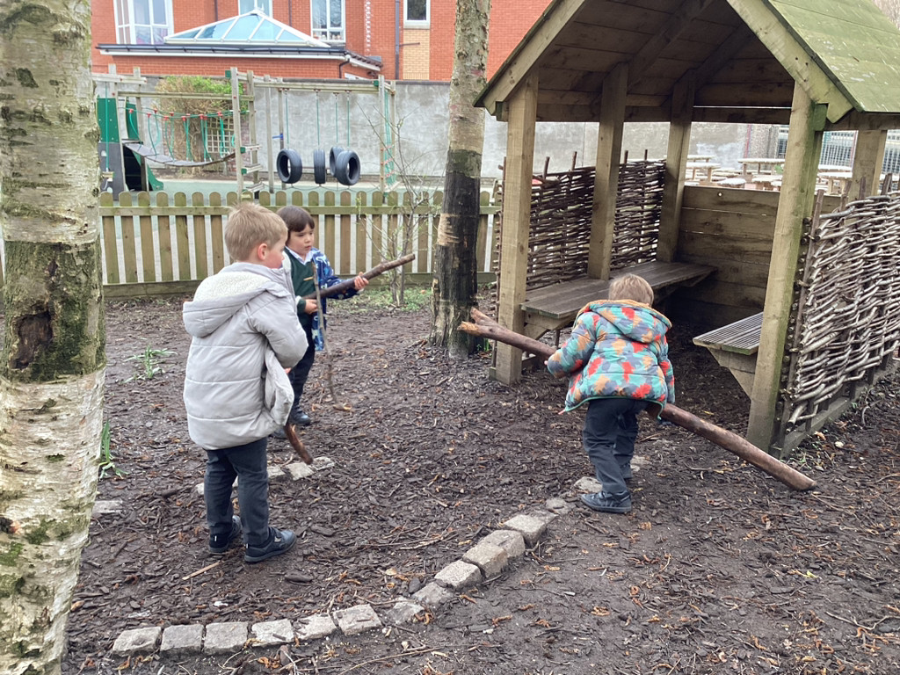
What do we already have in our playgrounds?

Slide 5
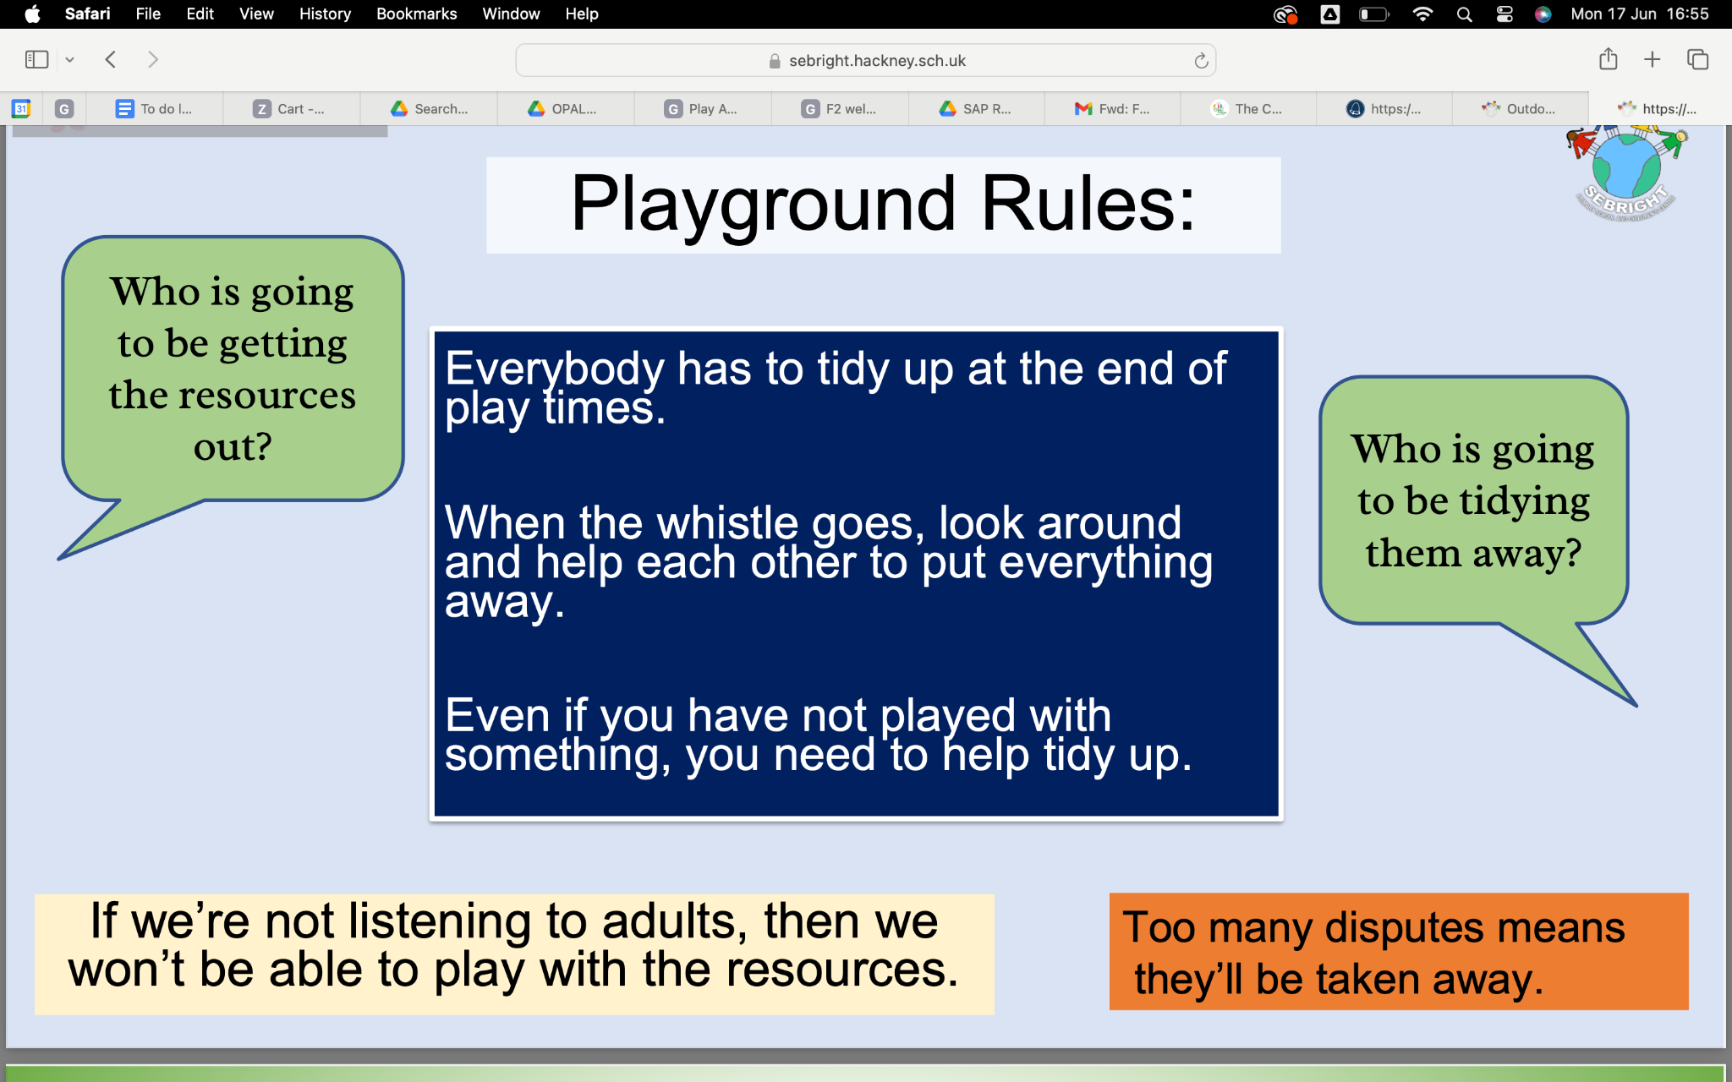
Our Current Playground rules…
Talk with a partner…
Where are our resources kept?
What are our playground rules?
Our playground rules (suggested by the children)
Kind hands and feet
Climbing to a sensible height
No escaping!
Treat people the way you want to be treated.
Be safe.
Don’t leave anyone out.

Slide 6

Why do we have rules?
To keep us safe!
To make sure we are all treated fairly.
To make sure things are orderly and calm.
To promote good choices.
Through OPAL, we want you to have a voice! As we start to make changes, we will use play assemblies like this to discuss/show new play resources, talk about the risks involved with using them and discuss how we can work as a team outside to keep everyone safe and having fun!

Slide 7
So..What’s coming next As we start OpAL?
Freedom Fridays! The first part of our OPAL journey is starting this Friday. During Freedom Friday all children will have access to play across both playgrounds (KS1 and 2) during lunch time.
Talk to your partner. What are the risks of this? How can we make sure this works and it’s fun for all of us? It would be great to make this a weekly thing!

Slide 8
Risk Management - how are we going to stay Safe?
Thinking - think before you do something.
Checking - is what you are doing safe?
has someone not gone in for lunch - remind them!
Looking - being aware of who or what is around you.
Listening - how will you know it is lunch time?
has the whistle been blown?
Our ‘Freedom Friday’ Rules:
Be gentle and mindful of each other.
When you hear the whistle, listen - is it your time to go in or line up?
Help your friends and those around you.
Adults to have walkie talkies and be placed across both sites.
Have fun!

Slide 9
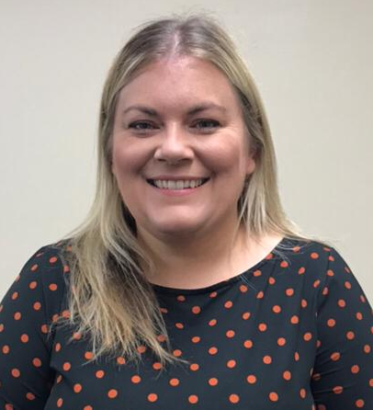
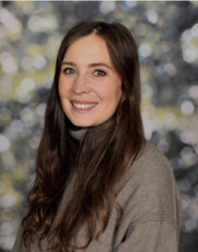
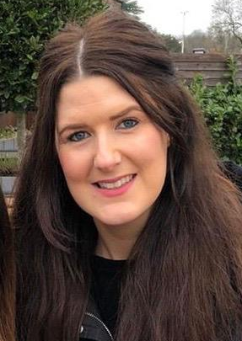
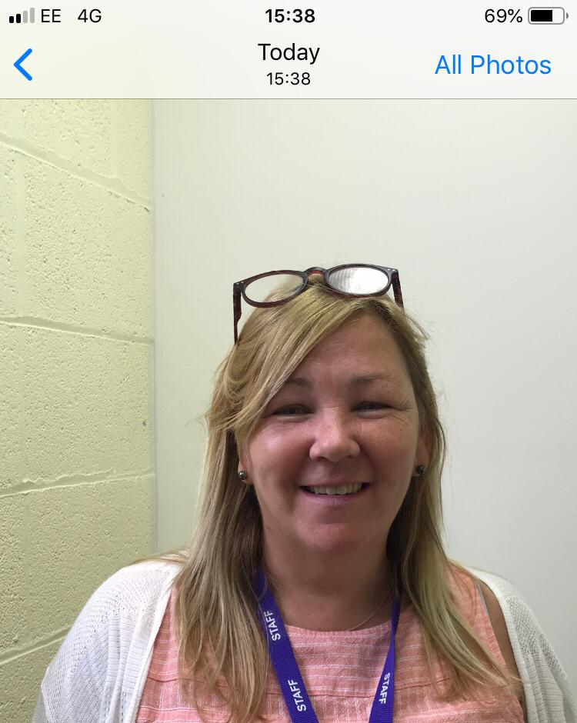
Our OPAL TEAm
Mrs Wright
Headteacher
Mrs Gunn
Curriculum Lead
Mrs Brown
Curriculum Lead
Mrs Davies
Play Co-ordinator

Slide 10
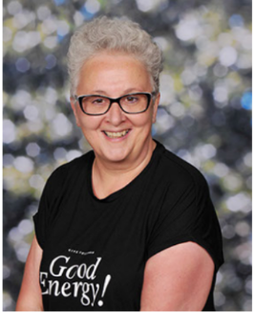
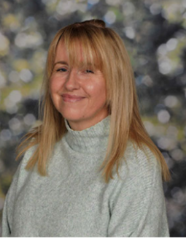
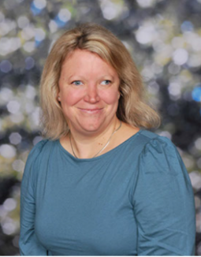
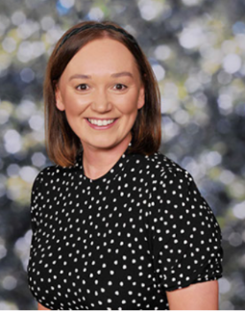
Our OPAL TEAm - your play leaders!
Mrs Sherlock
Play leader
Mrs Gardener
Play leader
Mrs Walton
Play leader
Mrs Loftus
Play leader
Mrs Cavagan
Play leader
Mr Irving
Play leader
Mrs Kyriazis
Play leader
Mrs Noble
Play leader
Mrs Karunara
Play leader

Slide 11

During our next play assembly, we will talk together about how Freedom Friday went and how we could make it even better next time.
OPAL SONG SUggestions?

